Slide 1
CASE STUDY
How a Leading US Logistics Co. built a Resilient Back-office team
Client Overview
The leading Logistics organization in North American with tens of thousands of customers across every zip code in the US. Their back-office team sits in various locations across India and the Philippines.
Key Challenges
Stabilize
Productivity
Maintain utilization
Maintain Quality Benchmarks
The backoffice team for the bank’s Global Captive Center (GCC) was using worxogo Nudge Coach and was a highly productive and efficient team. The team was motivated and engaged and maintain their quality benchmarks across the board. When the pandemic hit, teams were forced to work-from-home (WFH) overnight.
The management wanted to ensure that their team’s productivity and quality was not affected while ensuring that their morale, motivation and engagement remained high.

Slide 2
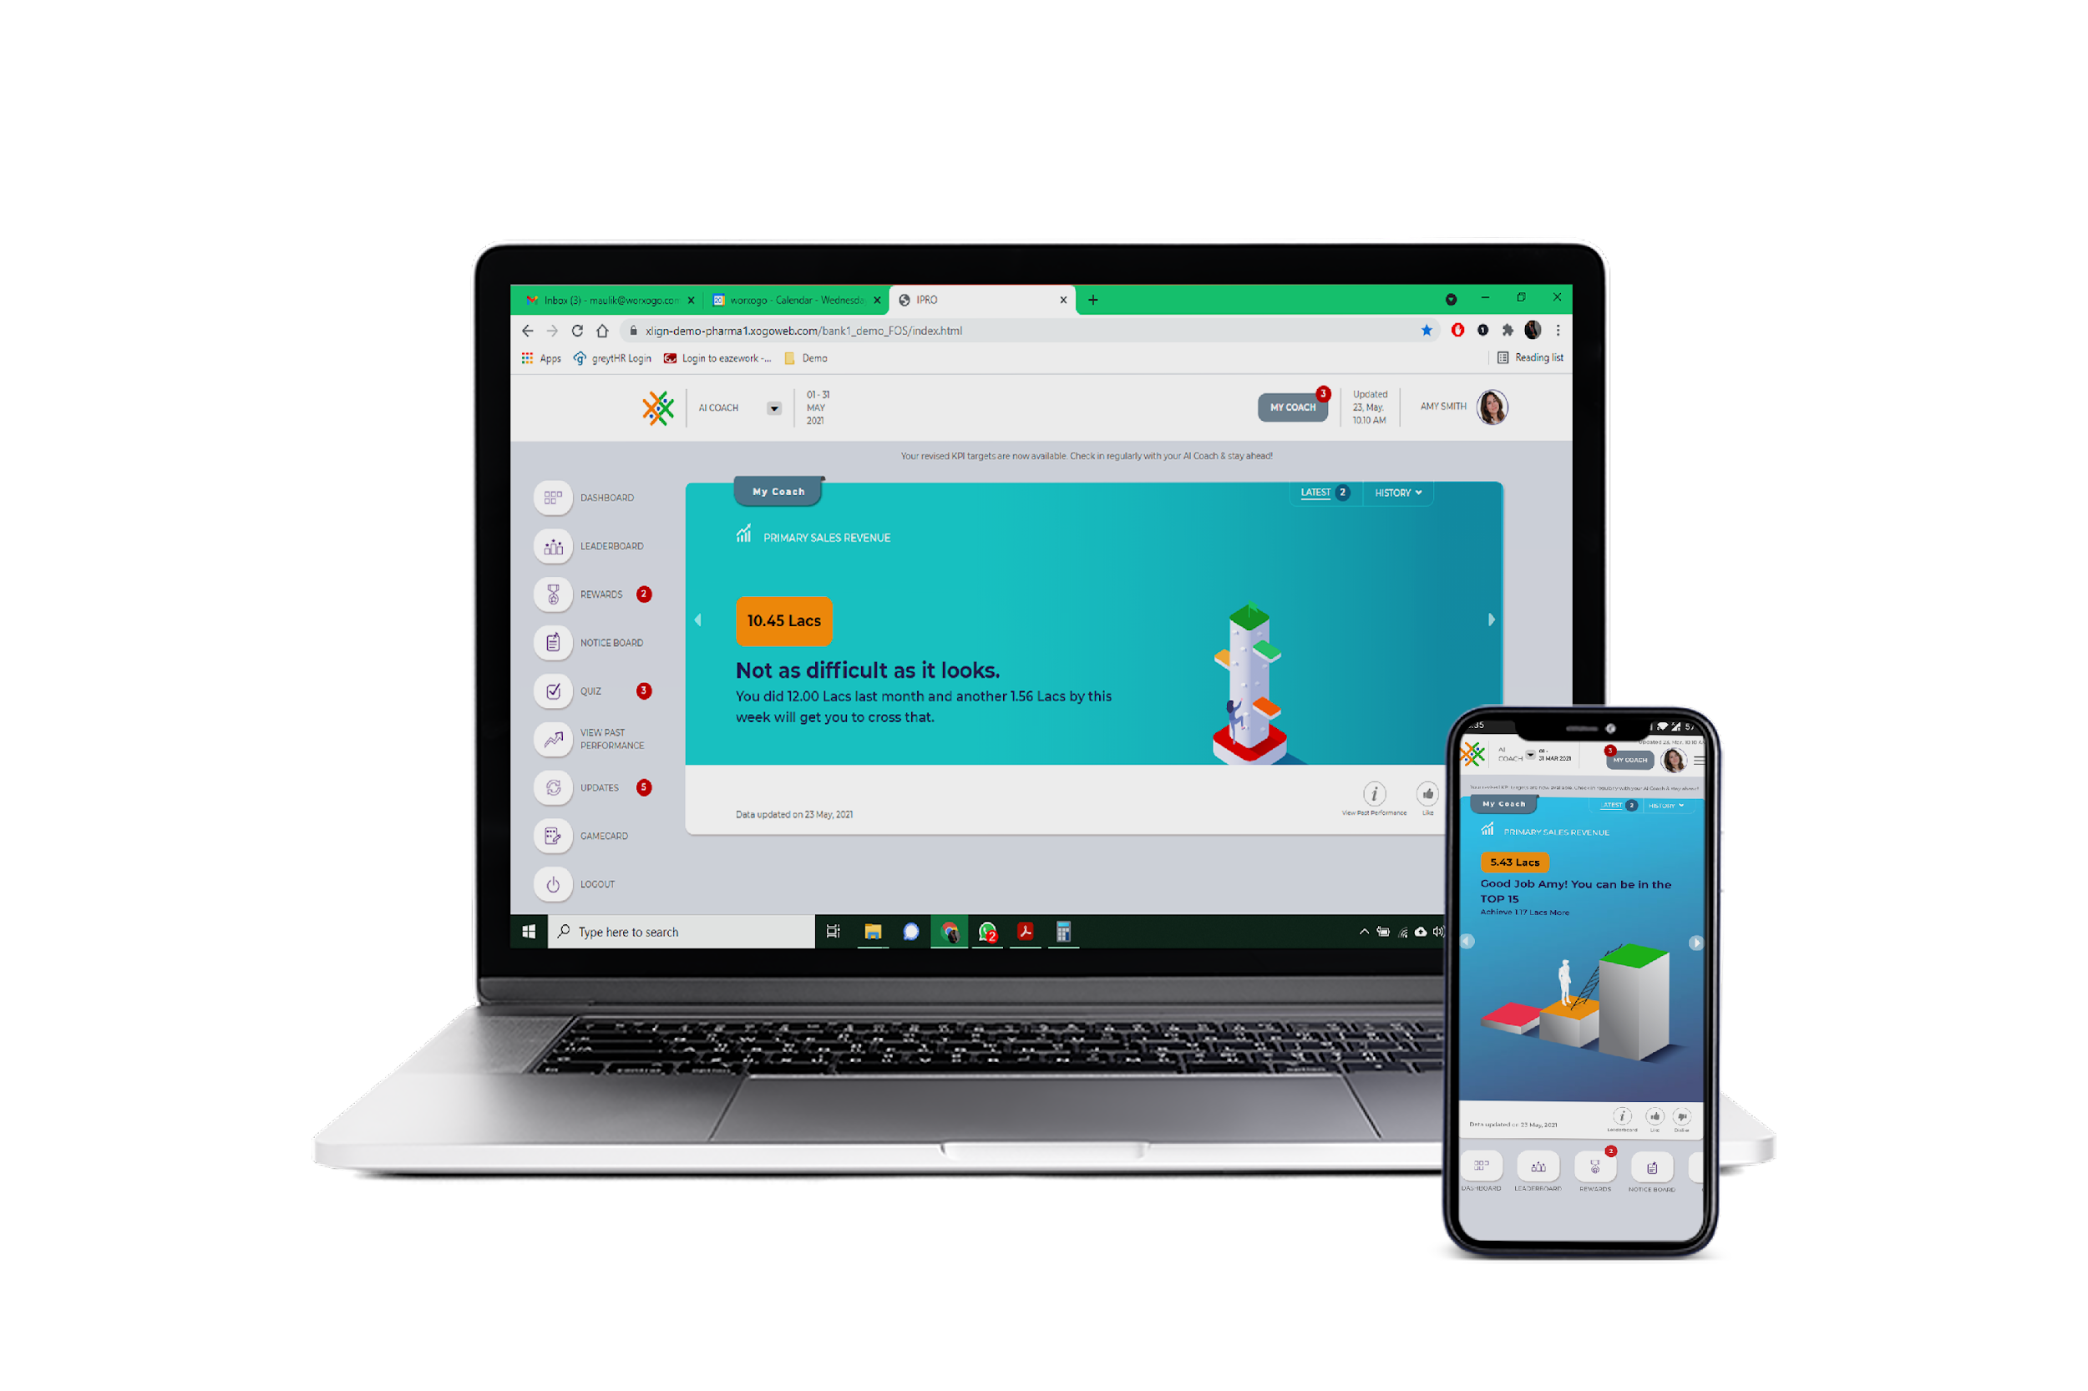
Nudge Coach Deployment
worxogo Nudge Coach was already deployed at the Logistics Company’s back-office team. Based on the Nobel prize-winning concept of Nudges, the coach nudged the team on daily activities to improve their productivity. Pre pandemic the team was highly productive and during the disruption, management quickly pivoted using the Nudge Coach to stabilize the team through the crisis.
The nudge coach helped the team self-manage themselves. Daily coaching tips / nudges helped them stay on track with their work rhythm. Microlearning were helps them get up-to-speed with the new way of working.
Managers were coached with insights and nudges that enabled them to pivot to managing their remote teams and coaching them regularly and consistently.
The Outcome
21%
14%
97%
Improved Productivity
Increased Utilization
Quality level maintained
The management used worxogo Nudge Coach to build a resilient team that not only withstood but thrived in the crisis. Worxogo Nudge coach became a bridge between managers and their teams connecting them to each other, helping them remain engaged, motivated and Productive
www.worxogo.com
Join the future of work today Contact: sales@worxogo.com

