Slide 1
CASE STUDY
How a Leading UK Bank GCC increased Team Productivity by 14%
Client Overview
One of the largest retail and commercial banks in the UK, this bank has over 60,000 employees. The bank’s Global Captive Center (GCC) is located in India and the Philippines. The management was looking to improve their hybrid backoffice team’s productivity and utilization.
Key Challenges
Increase
Productivity
Improve utilization
Increase Core Time
The backoffice team for the bank’s Global Captive Center (GCC) was a hybrid team that was working in-office and remotely in India and the Philippines. The team was experiencing variable productivity. The management wanted to ensure that each associate was being productive consistently.
Moreover, the management was looking to improve the utilization of each resource while making sure that most of their time at work was being spent in core activities, rather than non-core activities.

Slide 2
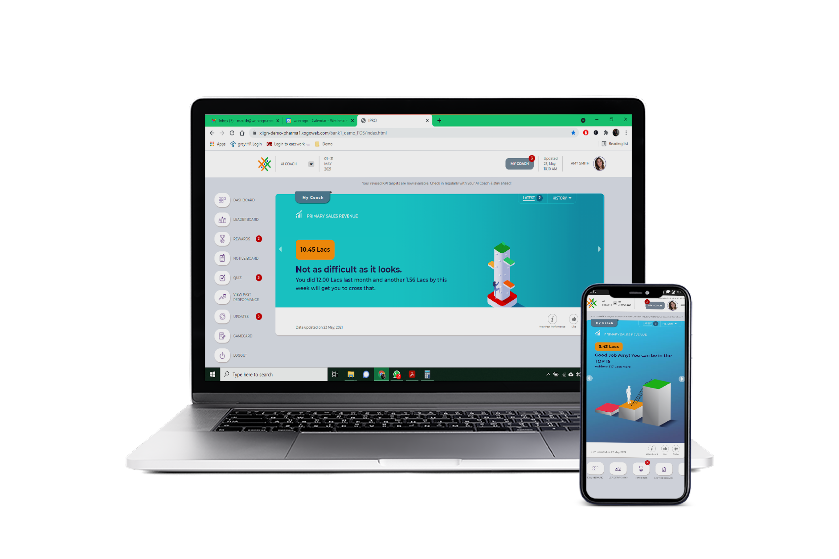
Nudge Coach Deployment
worxogo Nudge Coach was deployed at the backoffice teams in the bank’s Global Captive Centers (GCC). Based on the Nobel prize-winning concept of Nudges, the coach nudged associates on daily activities that would improve their productivity. The AI Nudge Coach helped the team build consistency around high-impact work behaviors using visual progress trackers, rewarding them for 3-day streaks and nudging the team towards their targets.
Teams got into the habit of spending 3-5 mins with their AI coach which helped them focus on their priority KPIs and pay attention to problem areas. Virtual rewards, recognition and leaderboards kept the teams motivated and enthused to perform at their best, while microlearning modules enhanced the team’s knowledge of processes.
Managers got a bird’s eye view of their teams’ performance and using a proprietary 2-click method they were able to send feedback to each associate based on their unique performance and motivational context. The Nudges and insights helped managers drive a culture of consistent performance.
The Outcome
14%
10%
6%
Higher Productivity
Increased Utilization
Increase in Core Activity
With the deployment of worxogo Nudge Coach, a clear behavior change was seen in the entire team – as most of the associates not only adhered to but moved beyond their defined targets, to become a more motivated, engaged and productive team.
www.worxogo.com
Join the future of work today Contact: sales@worxogo.com

